Slide 1

Designing a community based intervention to address air pollution in my local area
Prepared By:
Soubia Afroje Lubna
ID No: MOP00012
Batch: 02
Microft Office Package, EDGE

Slide 2
Contents
Identify the issue
Pollutants level around the brickfields in my area
Ambient air quality for Bangladesh and WHO guideline
Community Engagement
Intervention Design
Evaluation and Sustainability
Ethical Consideration

Slide 3
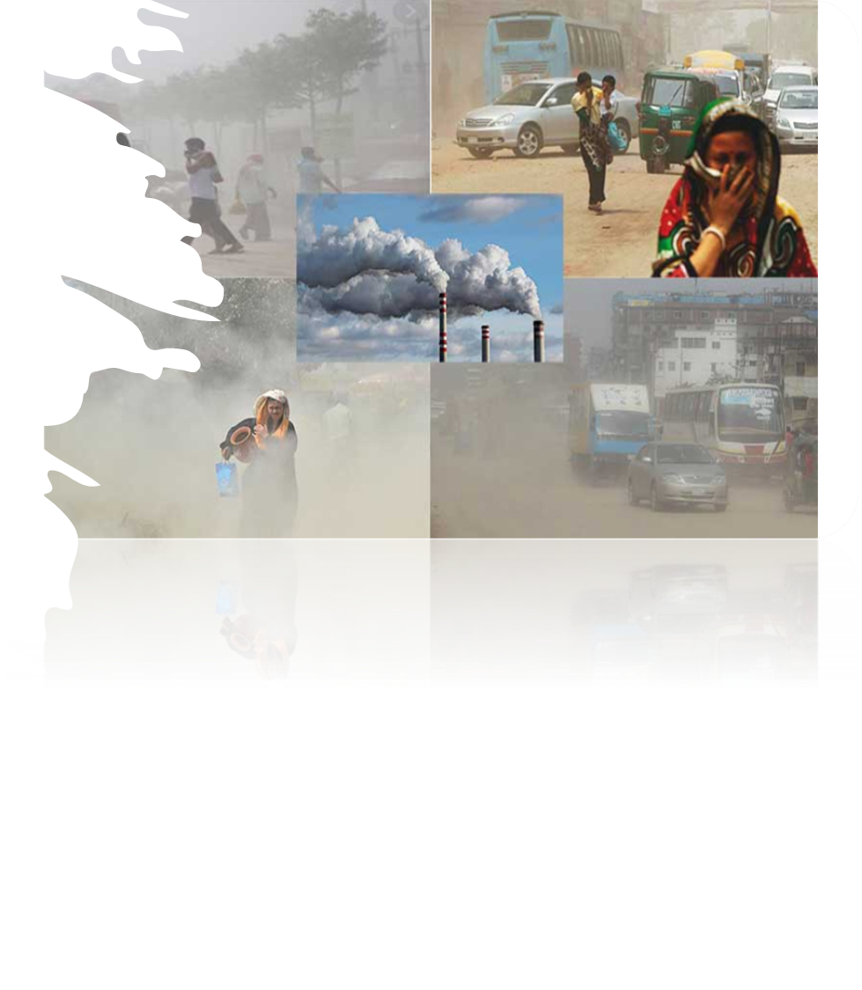
IDENTIFYING THE ISSUE
Poor air quality is a major concern for the health of people in my local area.
Air pollution, caused by chemical, physical, and biological agents, can harm people's health due to sources like household combustion devices, motor vehicles, and industrial facilities. Major health concerns include carbon dioxide, ozone, nitrogen dioxide, and sulfur dioxide.
Air pollution in my area, primarily caused by biomass burning, factories, construction dust, and waste burning, is increasing the risk of respiratory and cardiovascular diseases among residents.

Slide 4
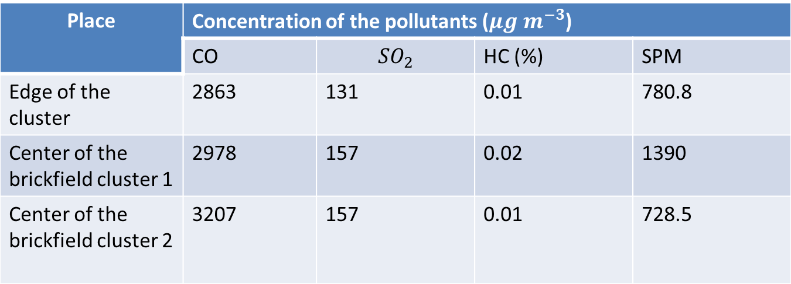
Pollutants level around the brickfields in my area
Place
 | CO |  | HC (%) | SPM
Edge of the cluster | 2863 | 131 | 0.01 | 780.8
Center of the brickfield cluster 1 | 2978 | 157 | 0.02 | 1390
Center of the brickfield cluster 2 | 3207 | 157 | 0.01 | 728.5

Slide 5
Ambient air quality for Bangladesh and WHO guideline

Slide 6

Community engagement
Educating people about air pollution's health impacts and reducing exposure ultimately leading to healthier living conditions.
To reduce air pollution, we should promote healthy behaviors such as carpooling, using public transportation, proper trash disposal, and tree planting in our community.
We can organize community campaigns to decrease the level of air pollution in our region.
People can take actions like writing to MPs, engaging with the community, and joining pressure groups to increase self-efficacy and bring behavioral change.
By fostering community connections, fostering trust through counseling, and encouraging shared responsibility, we can work together to mitigate air pollution.

Slide 7
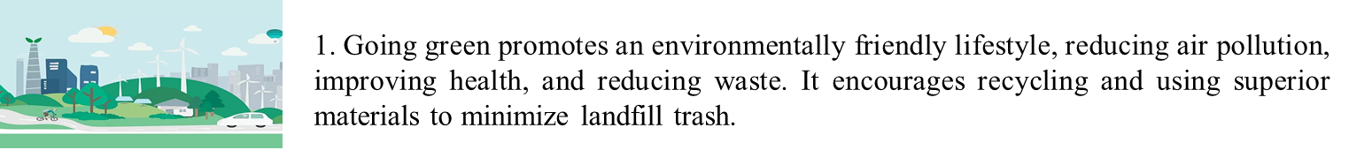
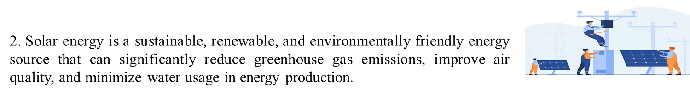
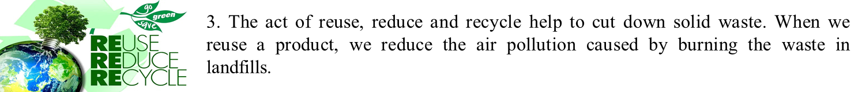
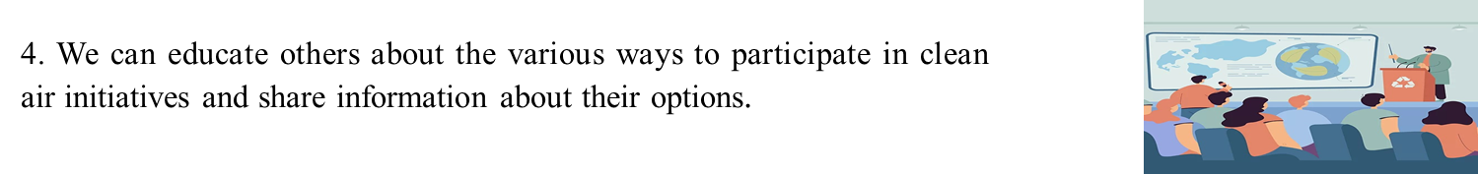
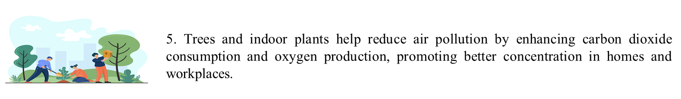
Intervention Design

Slide 8
Evaluation and Sustainability
Monitoring air quality before and after interventions is crucial to determine the effectiveness of the intervention and determine whether to sustain or increase it.
The impact of interventions on the community can be assessed through surveys or health assessments.
To guarantee the sustainability of our interventions, we plan to establish partnerships with local organizations.
The recommendation is to implement capacity building initiatives to tackle the long-term issues linked to air quality in our local area.

Slide 9
Ethical Consideration
The interventions should be inclusive of all community members, regardless of their background or financial status, as everyone has an equal right to clean air.
The decision-making process for interventions should be transparent.
The design of interventions should take into account social and cultural customs.
We should try our level best to minimize all kinds of negative effects of the interventions.

Slide 10

Thank You

